Slide 1
WELCOME TO THE
ACTUARIAL ASSOCIATION
Banquet
Mosher Alumni House
5/8/18 6:00-9:00 pm
WE WANT TO SAY
THANK YOU
AND CONGRATULATIONS

Slide 2
Schedule
WELCOME …………………………………………………………………………………. 6:00-6:45 pm Table introductions/Icebreaker
Photos
MEAL …………………………………………………………………………………………. 6:45-7:30pm
Dinner
RECOGNITION AND CONGRATULATIONS …………………………………. 7:30-8:00 pm
Volunteers
Case Study Participants
Exam Passers
Graduating Seniors
Current UCSB AA Officer Thank You
New UCSB AA Officer Pinning
Faculty and Staff Recognition
WHAT TO LOOK FORWARD TO ………………………………………………….. 8:00 - 9:00 pm
Upcoming Events
Dessert
Drinks (unfortunately not)

Slide 3
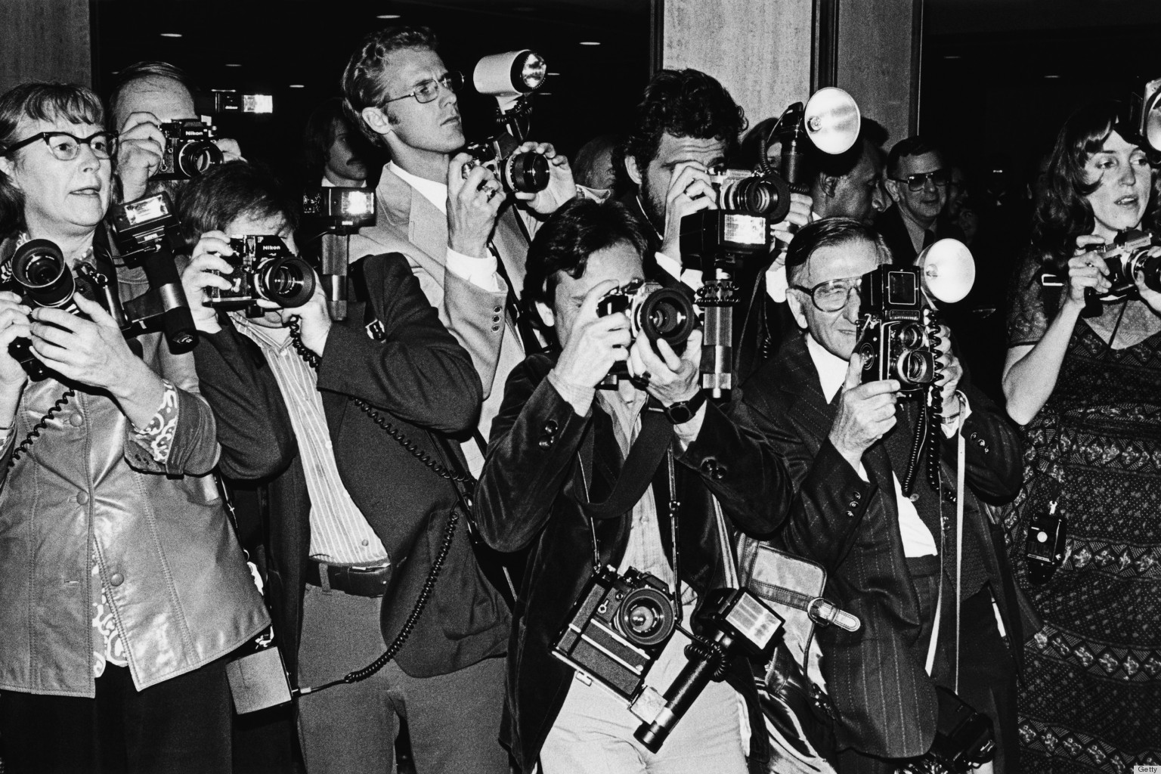
Photos

Slide 4
AA 2016-2017 Slideshow
https://www.youtube.com/watch?v=kFTpCH9AM90&feature=youtu.be

Slide 5
Volunteer Recognition
MARTINA ROSEN
2018 COMMUNITY DIRECTOR
JANET LIN
2017 COMMUNITY DIRECTOR
Jiayin Liu
Leslie Medina
Janae Michaela Romek
Karla Orocio Baez
Daniel Rondon
Martina Rosen
Jonathan Trinh
Jessie Xu
Helen Xu
Syen Yang Lu
Ming Yi
Peter Yin
Sam Zhang
Dongyao Zheng
John Zhou
Tiffany Chang
Ishaab Chhabra
Evelyn Fang
Evelyn Fang
Glynnis Foley
Meet Gala
Kyle Guan
Ryan Ho
Darius Hsieh
Martin Hua
Ariel Huang
Permoon Hussaini
Jordan Jang
Stephanie Lee
Janet Lin
Notes:
Jonathan Trinh
Janae Michaela Romek
Karla Orocio Baez
xinyuan zhang
Permoon Hussaini
Tiffany chang
Ariel Huang
Janet Lin
Daniel Rondon
Ryan Ho
Peter Yin
Leslie Medina
Martina Rosen
Martin Hua (Zhaoming Hua)
Jessie Xu
John Zhou
Ishaab Chhabra
Stephanie Lee
Meet Gala
Helen Xu
Evelyn Fang
Richard Bohong Qian
Ming Yi
Dongyao Zheng
Jiayin Liu
Kyle(YanJia) Guan
Syen Yang Lu
Darius Hsieh
Evelyn Fang
Permoon Hussaini
Jordan Jang
Glynnis Foley

Slide 6
Case Study Participants
MING YI
2018 SECRETARY
JORDAN JANG
2017 JOURNALIST
CAL Actuarial League 9th Annual Case Competition First Round
Team 1: Meet Gala, Ming Yi, Evelyn Fischer, Xinyuan Zhang
Team 2: Daniel Rondon, Chuqiao Amanda Liu, Dorothy Li, Achyuth Varma
Team 3: Syen Yang, Yokey Li, Shirley Gui, Kennard Reuss Peters
Team 4: John Zhou, Janet Lin, Jordan Jang, Joshua Chen
Team 5: Robert Boullon, Martin Hua, Eileen Zhu, Wenjing Li
Bruin Actuarial Society 6th Annual Case Competition First Round
Meet Gala
Syen Yang
Shirley Gui
Kennard Peters
Jordan Jang
Daniel Rondon
Eileen Zhu
Janae Romek
CAL Actuarial League 9th Annual Case Competition Final Round
Team 2: Daniel Rondon, Chuqiao Amanda Liu, Dorothy Li, Achyuth Varma
Bruin Actuarial Society 6th Annual Case Competition Final Round
Jordan Jang
Daniel Rondon
Eileen Zhu
Janae Romek
2018 SOA Student Research Case Study Challenge First Round
Meet Gala, Permoon Hussaini, Wenjing Li, Robert Boullon, Eileen Zhu
Notes:
2018 SOA Student Research Case Study Challenge

Slide 7
Exam Passers
JANAE ROMEK
2017 EXAM COORDINATOR
ARIEL HUANG
2018 EXAM COORDINATOR
P
Michael Brown
Ishaab Chhabra
Evelyn Fang
Shirley Gui
Bryan Hoang
Jordan Jang
Dorothy Li
Bidal Orozco
Martina Rosen
Jonathan Trinh
Helen Xu
Syen Yang Lu
Ming Yi
Sam Zhang
Eileen Zhu
FM
Michael Brown
Bryan Hoang
Darius Hsieh
Martin Hua
Dorothy Li
Jiayin Liu
Jia Liu
Janae Michaela Romek
Karla Orocio Baez
Daniel Rondon
Helen Xu
Ming Yi
Sam Zhang
Dongyao Zheng
Eileen Zhu
MFE
Richard Qian
C
Richard Qian

Slide 8
Graduating Seniors
JESSIE XU
2017 VICE PRESIDENT
SUKANYA JOSHI
2018 TREASURER
Karla Orocio Baez
Glynnis Foley
Katherine Goren
Ryan Ho
Darius Hsieh
Leslie Medina
Janae Michaela Romek
Bidal Orozco
Sandesh Shalavadi
Helen Xu
Dongyao Zheng
John Zhou

Slide 9
Current Officers
PERMOON HUSSAINI
2018 PRESIDENT
SAM ZHANG
2018 VICE PRESIDENT
Daniel Rondon (President)
Jessie Xu (Vice President)
Darius Hsieh (Treasurer)
Janae Romek (Exam Coordinator/Secretary)
Syen Yang Lu (Webmaster)
Helen Xu (Journalist)
Jordan Jang (Journalist)
John Zhou (Journalist)
Janet Lin (Community Director)
Meet Gala (Case Study Coordinator)

Slide 10
New Officers
DANIEL RONDON
2017 PRESIDENT
JESSIE XU
2017 VICE PRESIDENT
Permoon Hussaini (President)
Sam Zhang (Vice President)
Sukanya Joshi (Treasurer)
Ming Yi (Secretary)
Ariel Huang (Exam Coordinator)
Wenjing Li (Journalist)
Doris Padilla (Journalist)
Martina Rosen (Community Director)
Jordan Jang (Case Study Coordinator)

Slide 11
Staff and Faculty Appreciation
DANIEL RONDON
2017 PRESIDENT
DORIS PADILLA
2018 JOURNALIST
JESSIE XU
2017 VICE PRESIDENT
Sudeep Bapat
Jerry Chung
Ian Duncan
Janet Duncan
Raya Feldman
Pierre-Olivier Goffard
Roger Hayne
Xiyue Liao
Jiyoun Myung
Andrey Sarantsev
Moritz Voss
Notes:
Sudeep Bapat
Xiyue Liao
Ian Duncan
Pierre-O Goffard
Andrey Sarantsev
Raya Feldman
Jerry Chung
Jiyoun Myung
Moritz Voss
Roger Hayne

Slide 12
Actuarial Events
PERMOON HUSSAINI
2018 PRESIDENT

Slide 13
Dessert!

